Slide 1

MACHINE LEARNING RESEARCH
Proactive Traffic Congestion
Prediction and Signal
Optimization
Leveraging Historical Data and Time-Based Patterns
for Intelligent Urban Traffic Management
Presented by
Kathera Karthik
January 2026

Slide 2
01 / INTRODUCTION
The Urban Traffic Challenge
The Problem
Impact of Traffic Congestion
Rapid urbanization has dramatically increased the number of vehicles on roads, creating unprecedented traffic congestion in cities worldwide.
Time Wastage
Fuel Consumption
Hours lost in traffic daily
Unnecessary fuel burn
Pollution
Road Accidents
Current Signal Systems
Increased emissions
Safety hazards
Fixed-time schedules - Cannot adapt
Manual control - Human dependent

Slide 3
03 / LITERATURE SURVEY
Existing ML Approaches
Several ML-based traffic management systems have been proposed. Common techniques and focus areas are summarized below.
Random Forest
Computer Vision
Cloud Systems
Ensemble learning for traffic prediction using decision trees.
YOLO for real-time vehicle detection and tracking.
Scalable cloud platforms for real-time data processing.
Handles complex datasets
Vision-based analysis
Distributed computing
Primary Focus Areas
Research Gap
Real-time Detection
Monitor and respond to current conditions.
Existing solutions focus on reacting to current conditions. There is a need for proactive prediction to prevent congestion before it occurs.
Hardware Infrastructure
Require extensive physical deployment.

Slide 4
03 / LITERATURE SURVEY
Paper 1: Cloud-Enabled Analytics
"Dynamic Traffic Optimization Through Cloud-Enabled Big Data Analytics"
A cloud-based approach using Random Forest for real-time traffic optimization.
Core Technologies
Data Sources
Random Forest Algorithm
An ensemble learning method for traffic prediction using multiple decision trees for accuracy.
Sensors
GPS Devices
Social Media
Road embedded
Vehicle telematics
Incident reports
Cloud Computing & Big Data
System Capabilities
Leverages scalable cloud platforms to process large-scale traffic data in real-time.
Dynamic retiming: Adjusts signal timing in real-time.
Traffic rerouting: Suggests alternate routes.
Key Innovation: Integrates multi-source data for real-time optimization, but requires extensive hardware.

Slide 5
03 / LITERATURE SURVEY
Paper 2: Computer Vision Approach
"Traffic Management Using Computer Vision"
A vision-based system for real-time vehicle detection and density-aware traffic control.
Methodology
YOLO Features
1
Camera Deployment
Real-time Processing
Strategically placed cameras provide continuous visual feed of traffic conditions.
High FPS detection
High Accuracy
2
YOLO Object Detection
Precise detection
Advanced deep learning model for real-time vehicle detection.
Multi-scale Detection
Handles various sizes
System Workflow
Capture live video feed
Key Advantages
Apply YOLO detection
Real-time accuracy: Precise live data
Density-based: Adapts to actual conditions
Count vehicles in ROI
Automated: Reduces human error
Adjust signal timing

Slide 6
04 / PROBLEM ANALYSIS
Limitations of Existing Systems
Critical Drawbacks
Economic Barriers
Current systems face significant challenges in cost, scalability, and deployment.
Installation Cost
Initial capital expenditure is prohibitively high.
Heavy Hardware Dependency
Cameras
Maintenance Cost
High installation and maintenance costs.
Requires continuous monitoring and calibration.
Sensors
Requires extensive road-embedded infrastructure.
Reactive Nature
Most systems react to existing congestion, missing prevention opportunities.
Cloud Infrastructure
Ongoing operational costs and internet dependency.
Problem: Act too late to prevent gridlock
Result: Solutions are difficult to deploy at large scale, especially in resource-constrained regions.

Slide 7
04 / PROBLEM ANALYSIS
Identifying the Critical Gaps
Current System Analysis
The Urgent Need
Detection After Congestion Forms
A new paradigm is needed to transform traffic management.
Systems detect problems only after they occur .
Proactive Congestion Prediction
Forecast conditions before they happen.
Expensive Hardware Requirements
Deployment is prohibitively expensive .
Low-Cost & Scalable Solution
Affordable and easy to deploy widely.
The Proposed Solution Shift
Historical Data
ML Prediction
Proactive Optimization
Use existing archives.
Forecast congestion.
Act before problems.

Slide 8
05 / PROPOSED SOLUTION
Data-Driven Traffic Management
Proactive Congestion Prediction & Signal Optimization
A paradigm shift from reactive to proactive traffic management.
Historical Data
Time Patterns
ML Prediction
Past traffic records
Cyclical patterns
Forecasting models
Prediction Capabilities
Optimization Features
Forecast traffic volume: Predict vehicle numbers.
Dynamic timing adjustment: Adapt signal cycles.
Identify peak periods: Detect rush hours.
Green wave coordination: Enable smooth flow.
Estimate congestion probability: Assess risk.
Emergency prioritization: Clear paths for responders.
Core Innovation: Predicts congestion before it occurs, enabling preventive action.

Slide 9
02 / INTELLIGENT TRAFFIC MANAGEMENT
Why Intelligence Matters
Traffic Flow Dynamics
Machine Learning: The Proactive Solution
Traffic flow is highly dynamic and context-dependent, varying significantly across multiple dimensions.
ML transforms traffic management from reactive to proactive and predictive.
Learn Traffic Patterns
Time of day: Morning/Evening peaks
Analyze historical data to identify complex patterns.
Day of week: Weekdays vs Weekends
Predict Future Congestion
Forecast traffic volume before congestion forms.
Peak variations: Rush hour fluctuations
Optimize Signals in Advance
Adjust signal timings based on predictions.
Current System Limitation
Traditional systems react after congestion occurs , missing prevention opportunities.
Shift from "Reacting to Problems" → "Preventing Problems"

Slide 10
05 / PROPOSED SOLUTION
Key Features
01
02
03
Proactive Prediction
ML Decision-Making
No Camera Dependency
Forecasts congestion before it forms, enabling preventive action.
Uses data-driven algorithms for intelligent signal control.
Minimizes infrastructure needs by using existing data.
04
05
Cost-Effective & Scalable
Easy Real-World Deployment
Minimal hardware costs make it affordable for widespread deployment.
Designed for simple integration with existing traffic systems, minimizing disruption and enabling quick adoption.
Comprehensive Advantage: Combines prediction, cost-effectiveness, and scalability.

Slide 11
06 / SYSTEM ARCHITECTURE
Workflow of the System
01
Traffic Data Collection
02
Data Preprocessing
Gather historical traffic data from various sources.
Clean and transform raw data into structured format.
Vehicle counts, timestamps, location, weather
Handle missing values, outliers, normalization
03
Feature Engineering
04
ML Congestion Prediction
Extract and create meaningful features for ML models.
Train ML models to predict future traffic congestion.
Time features, day type, moving averages
Random Forest, SVM, Neural Networks
05
Signal Timing Optimization
06
Feedback & Improvement
Optimize signal timings based on predictions.
Continuous learning loop for model refinement.
Green time allocation, cycle optimization
Performance monitoring, retraining
End-to-End Automated Pipeline: From Data Collection → Continuous Model Enhancement

Slide 12
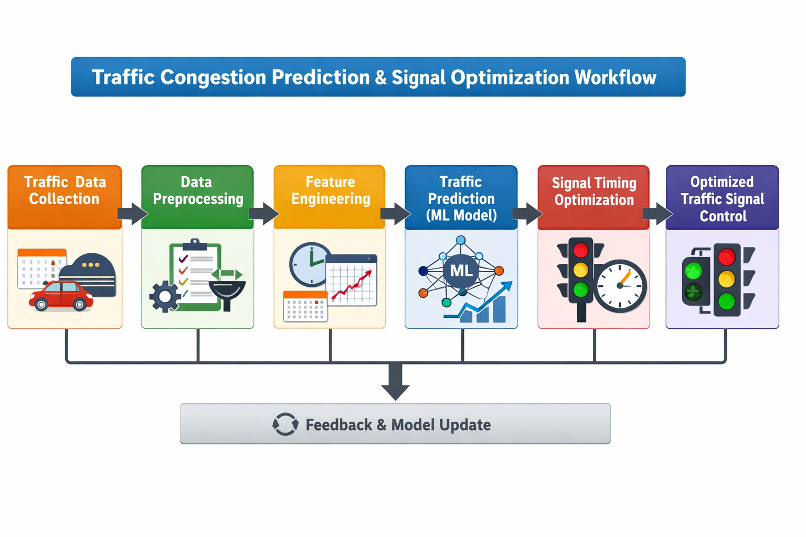

Slide 13
06 / SYSTEM ARCHITECTURE
Technology Stack
Programming Language
ML Libraries
Scikit-learn
ML algorithms
Python
Pandas
Rich ecosystem of ML libraries, simplicity, and versatility.
Data manipulation
NumPy
Numerical computing
Visualization Tools
Development Tools
Jupyter Notebook
Matplotlib
Seaborn
Interactive environment for data analysis, visualization, and experimentation.
2D plotting
Statistical plots
Tech Stack: Python + Scikit-learn + Pandas + NumPy + Matplotlib + Jupyter

Slide 14
07 / SYSTEM REQUIREMENTS
Functional & Non-Functional Requirements
Functional Requirements
Non-Functional Requirements
Predict congestion levels
Scalable
Accurately forecast traffic for different time horizons.
Handle growing data volumes and multiple intersections.
Reliable
Optimize signal timings
Consistent performance with minimal downtime.
Dynamically adjust signal parameters based on predictions.
Cost-effective
Minimal infrastructure to reduce TCO.
Process historical data
Accurate
Efficiently handle large volumes of past traffic data.
High prediction accuracy for effective signal control.
Handle Large Datasets
Easy to Understand & Maintain
Efficient processing of high-volume traffic data
Clear documentation for long-term sustainability

Slide 15
08 / BENEFITS
Advantages of the Proposed System
Reduces Congestion
Saves Time & Fuel
Improves Efficiency
Prevents traffic buildup, ensuring smoother flow.
Reduces travel time and fuel consumption.
Maximizes throughput and minimizes delays.
Minimal Infrastructure
Suitable for Developing Regions
Requires no expensive cameras or sensors, reducing costs.
Particularly beneficial for regions with limited infrastructure and budget constraints.
Uses existing traffic data archives
Standard computing hardware
Addresses rapid urbanization challenges
Easy integration with signal controllers
Quick deployment without major construction
Improves quality of life in urban areas
Environmental Impact: Reduces emissions by minimizing idling time and stop-and-go traffic.

Slide 16

09 / CONCLUSION
Transforming Urban Traffic Management
The Urban Problem
Current Limitations
Our ML Solution
Traffic congestion is a major urban challenge with significant impacts.
Existing systems are reactive, costly, and difficult to scale.
Proactive, cost-effective, and scalable approach using ML.
Key Contributions
Proactive Prediction: Forecasts before it occurs
Cost-Effective: Minimal infrastructure needs
Data-Driven: Uses historical patterns
Scalable: Deployable across cities
Future Vision: A step toward smarter, more efficient cities

Slide 17


Thank You!
Questions & Discussion
Presented by
Kathera Karthik
Email
Academic
January 2026
"Transforming Traffic Management Through Intelligence"

